Slide 1

DevOps Webinar
January 13, 6 PM – 8 PM GMT-5

Slide 2

Agenda
6:00 — 6:10 p.m.
Introduction
6:10 — 6:40 p.m.
Trusting in our IaC approach
6:40 — 7:10 p.m.
API Gateway Integration with Private Resources on EKS
7:10 — 8:10 p.m.
Cloud Native Approach using Oracle Functions
8:10 — 8:20 p.m.
Q&A session

Slide 3

ABOUT EPAM ANYWHERE
EPAM Anywhere es una plataforma de trabajo remota para profesionales de TI que ofrece asignaciones de tiempo completo, oportunidades de proyectos globales y muchos beneficios corporativos. Con EPAM Anywhere, no tienes que elegir entre la flexibilidad de un freelance y la estabilidad de de un trabajo de oficina; puedes disfrutar de las ventajas de ambos.
Más de 2 mil profesionales de TI en más de 15 países ya se han unido a nosotros y estamos agregando nuevas vacantes de Javascript todos los días, ¡te invitamos a estar pendiente!

Slide 4

EPAM Anywhere hoy
El programa de EPAM Anywhere está disponible para profesionales de TI en 15 países:
2200+
15+
Armenia
Azerbaiyán
Bielorrusia
Brasil
Chile
Colombia
Georgia
India
Italia
Kazajstán
Kirguistán
Polonia
Rusia
Ucrania
Uzbekistan
Profesionales
Países

Slide 5

IaC beyond terraform
Speaker: Daniel Rivera,
Senior Systems Engineer @EPAM Anywhere

Slide 9

Kubernetes
Speaker: Gabriel Banchs,
Senior Systems Engineer @EPAM Anywhere

Slide 13
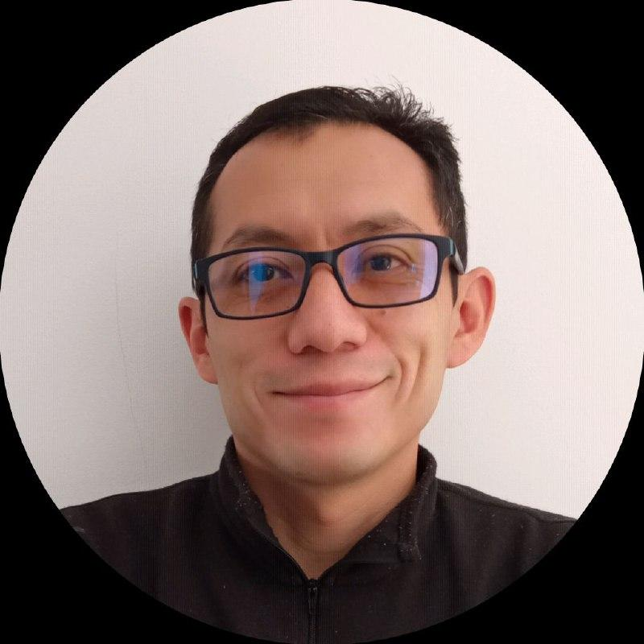
Cloud Native Approach using Oracle Functions
Speaker: Francisco Moreno,
Cloud Solutions Architect @Oracle
https://github.com/fmorenod81/expanddevopsview2022

Slide 14

Agenda
Buenas practicas de desarrollo
Aproximación: Principios de Diseño y Patrones
Horizonte para Desarrollo de Aplicaciones según Oracle
Introducción al Fn Project
Demostración en Entorno Hibrido
“(Alicia) – ¿Podrías decirme, por favor, qué camino debo seguir para salir de aquí? (Gato) – Esto depende en gran parte del sitio al que quieras llegar. (Alicia) – No me importa mucho el sitio… (Gato) – Entonces tampoco importa mucho el camino que tomes”.

Slide 15
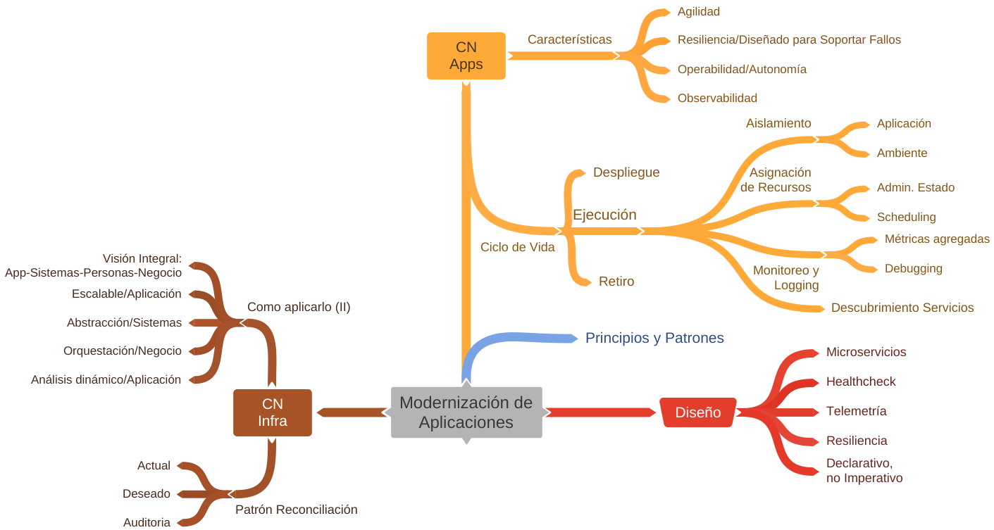
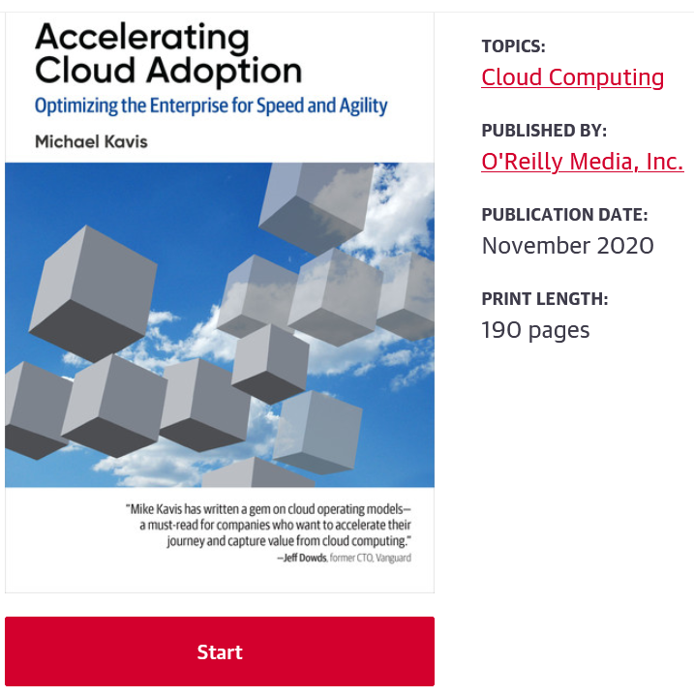
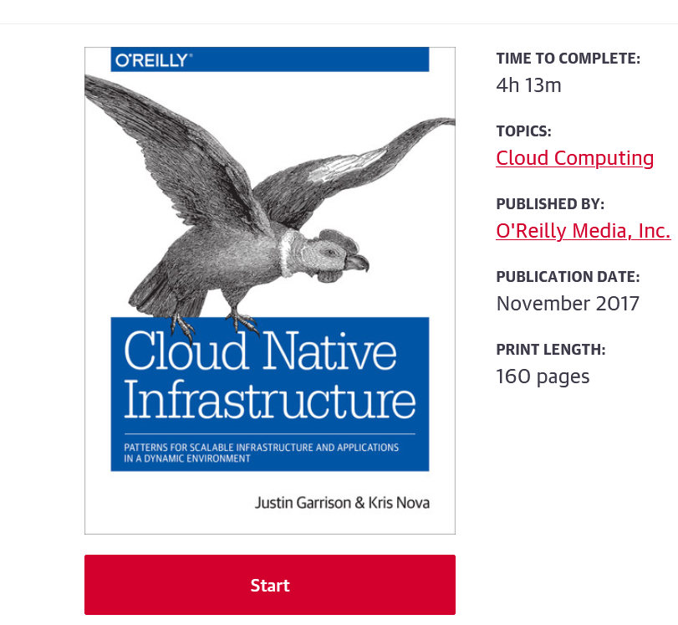
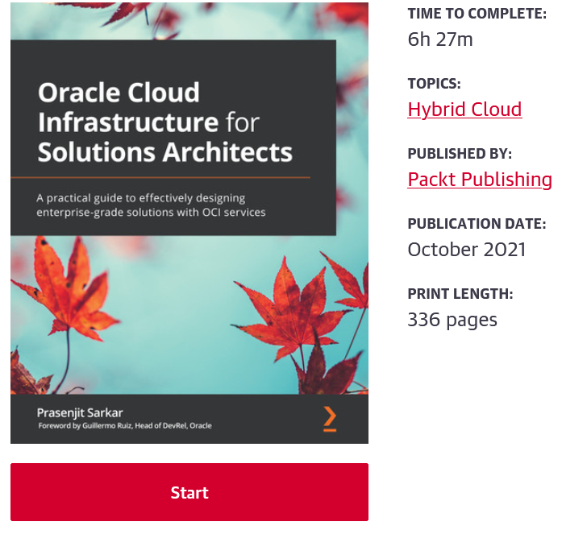
Buenas Practicas de Desarrollo
“(..) empower organizations to build and run scalable applications in (..) clouds.
Containers, service meshes, microservices, immutable infrastructure, and declarative APIs exemplify this approach.
(..) enable loosely coupled systems that are resilient, manageable, and observable.
Combined with robust automation, they allow engineers to make high-impact changes frequently and predictably with minimal toil.”
CNCF Definition

Slide 16
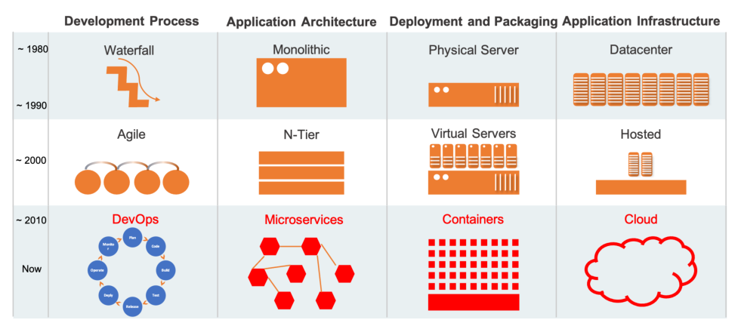
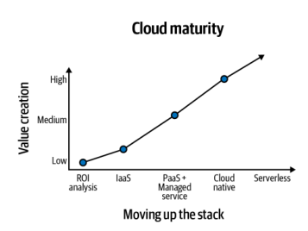
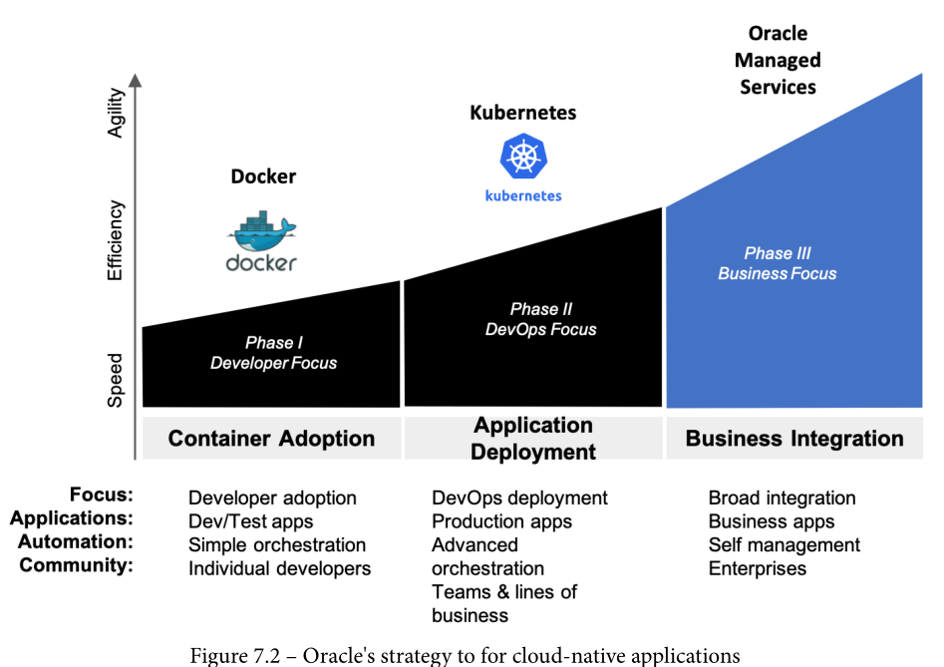
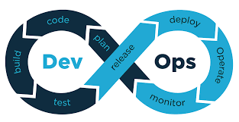
Contexto
Autogestión | Microfrontends | Serverless | MultiCloud

Slide 17
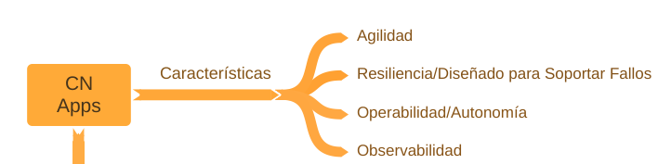

Pero las nuevas aplicaciones son complejas, un aliado simplifica el camino
Características
Beneficio
Diferenciador OCI
Agilidad
Acelerara la entrega de servicios de alta calidad usando CI/CD y automatización
Blueprint para el Desarrollo de Aplicaciones
Construcción, iteración y despliegue de aplicaciones mas rápido
Time-to-market reducido
Plataforma complete para migrar, optimizar y modernizar aplicaciones
Construcción de aplicaciones low-code
Escalable
Escalar automáticamente
Infraestructura flexible con auto escalamiento (y redimensionamiento): Horizontal y Vertical
Adopción de Estándares de código abiertos y portables para evitar el vendor lock-in
Selección correcta de lenguajes de programación y frameworks basado en la necesidad de la aplicación
Soporte los estándares de código abierto, servicios y frameworks así como su extensión
DevOps Toolchain para automatización
Agnóstico a plataforma y lenguaje
Seguridad
Mejores practicas por defecto
Facilidad para ejecutar apps en una gestión segura (CSP)
Seguridad Sencilla, Prescriptible e Integrada a través de IaaS, PaaS y SaaS
Copyright © 2019, Oracle y/o sus filiales. Todos los derechos reservados.

Slide 18
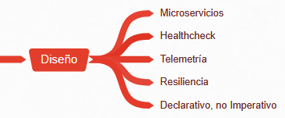
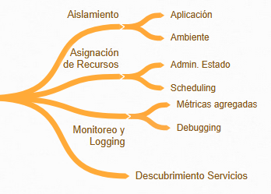
Como lo hace y como se ejecuta?
Diseño:
Microservicios: Contenedores y Funciones (Serverless)
Healthcheck: Sondas y Agentes
Telemetría: Métricas sobre funcionamiento
Declarativo: Características de la aplicación
Ejecución:
Aislamiento: Dividir funcionalmente.
Asignación de Recursos: Disponible y Adecuado.
Monitoreo y Logging: Comportamiento y Mejora.
Asignación de Recursos/Monitoreo y Logging: Escalamiento.

Slide 19
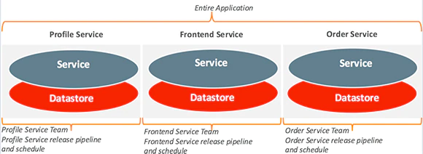
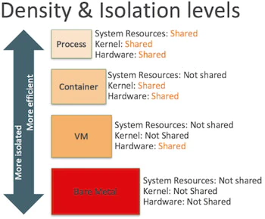
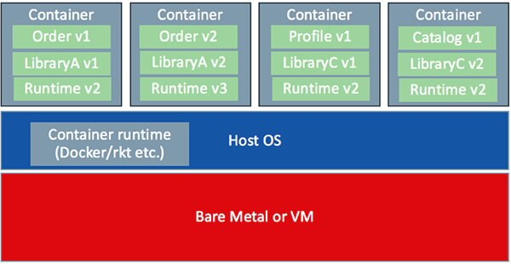
Retos Diseño I
Información Separada?
Aislamiento: Funcional (Microservicios), Aplicación (Contenedores), Ambiente (IaC).
Optimización: Uso Hardware (Contenedores), Costo (Serverless)

Slide 20
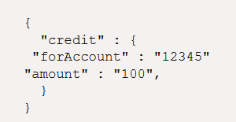
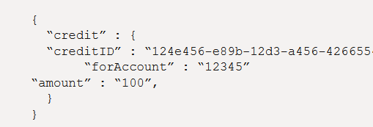
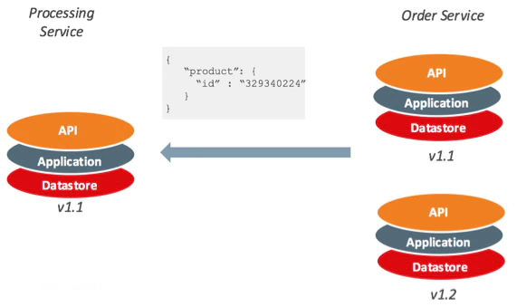
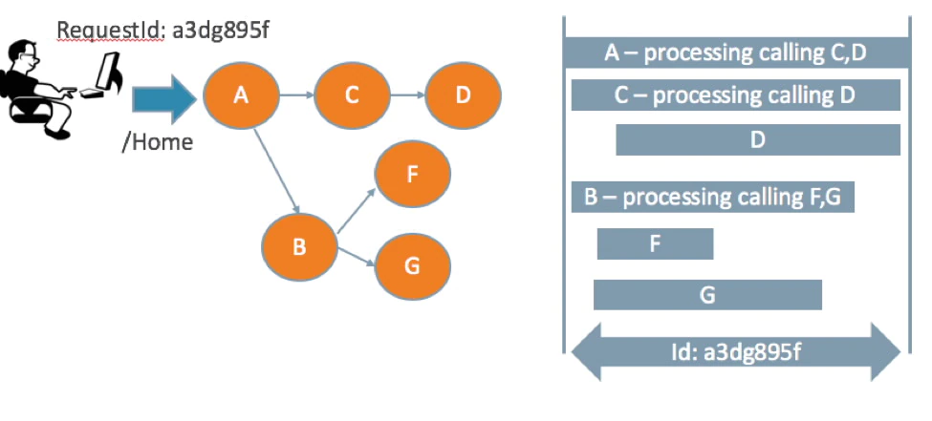
Retos Diseño II
Necesidad Versiones y Compatibilidad hacia atrás
Patrones de Diseño:
Queries: Request/Response, Materialized View, Request/Reply (Queue Directional/2).
Command: Una Cola. Otro canal para replicar (i.e. PSE)
Events: Choreography
Politicas: Reintento, Circuit Breaker, Bulkhead (Limitar alcance servicios), Cache, Fallback.
Necesidad Idempotencia en Trx.
Trazabilidad Distribuida

Slide 21
Principios de Diseño de Aplicaciones Modernas
Uso de frameworks ligeros y de código abierto así como lenguajes de programación maduros
Construcción de aplicaciones como servicios que se comunican a través de APIs
Empaquetado y despliegue de apps como contenedores
Construcción, prueba y despliegue automático
Servicios completamente administrados para eliminar complejidad a través de desarrollo de aplicaciones, runtimes y datos
Mantener capa de aplicación sin estado
Uso de bases de datos convergente con soporte completo a través de cualquier tipo de dato
Recolectar métricas end-to-end (E2E) y monitoreo
Eliminar puntos de falla (SPOF) a través de datos replicados y recuperación de fallas
Implementar una aproximación de defensa en profundidad para asegurar el ciclo de vida de las aplicaciones
Copyright © 2019, Oracle y/o sus filiales. Todos los derechos reservados.
Notes:
{Sajan to update by end of week)
Slide notes:
Make sure this text ends up on the website: While we provide technology recommendations for each of the principles, customers will be able to meet the principles and the underlying requirements using alternative services, technologies or methodologies.
Latest design principles here: NEW/REVIEW/incorporate changes from Sajan
https://confluence.oci.oraclecorp.com/display/DEVSVC/RefArch+Design+Principles

Slide 22





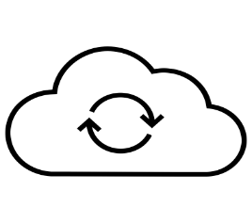

















Web/ Mobile Microservices
Patrón de arquitectura
Visión Oracle
Framework Ligeros y abiertos
DB convergentes y multimodelo
Poliglota es adecuado, use según necesidad
Seguridad en cada capa
Automatización DevOps
Beneficios
Use su lenguaje y framework favorito
Contenedores manejados reducen tiempo de despliegue
DB convergente reduce administración, independencia de ciclos de desarrollo, etc.
Casos de Uso
e-commerce
Online banking
Apps de Entregas
Sistemas de Recomendación
DNS
DDoS Protection
WAF
CDN
Oracle Identity Cloud
Public internet
VCN
Public subnet
Private subnet
API Gateway
Load
Balancer
Containerized microservices
OKE cluster
Private subnet
OKE Cluster
Multi-model DB
Private subnet
Autonomous Database
Object
Storage
Row
Row
Column
Graph
Copyright © 2019, Oracle y/o sus filiales. Todos los derechos reservados.
Notes:
Database Management with Cloud Native Apps (microservices) Is Hard. With more micro-services, we can have a sprawl of specialized databases that will result in challenges with Data integration, data security, varied developer skillsets
Multi-model database
Any data type: relational, object, XML, JSON, graph, spatial, text, more…
Any programming language: Java, .NET/C#, JavaScript/Node.js, Python, APEX, more…
Any workload: OLTP & OLAP
Build intelligent apps leveraging ML & advanced analytics
Develop cloud native apps using containers, microservices and serverless
Easy of Access with CLI / REST API
Instant performance analysis through Performance Hub
Autonomous delivers higher performance, security & availability using ML
Performance: Continuous auto-indexing & auto-SQL-planning (self-tuning)
Security: ML helps protect your data from external and internal threats
Availability: ML predicts failures and applies corrective actions. OOTB HA with RAC & ADG.
Scalability: Zero downtime scaling
Design principles
Use lightweight open-source frameworks and mature programming languages
Package and ship apps as lightweight containers
Build your apps as microservices that communicate over APIs
Use cases
e-Commerce
Recommender system
Online banking
Food delivery app
Ride hailing services
Vendor management system
Life of a query: The user request looks up the web app URL in OCI DNS. The DNS routes the request either to:
- the API gateway (for dynamic content), or
- CDN (for static content) (ETA: GA Dec 21)
In either case, the request is routed via DDoS protection and WAF. Requests hitting the CDN return cached content from the CDN. The CDN cache is backed by OCI object store (in the current state, we would need a web server fronting the object store).
When javascript is executed on the browser or on the mobile app it will make calls to the api endpoints such as api.example.com, the request goes to the API Gateway.
An API Gateway lies in between the external clients and the applications. It acts as a reverse proxy that routes requests from the external client to the application.The API Gateway checks to see if the user has proper authorization and has signed in through an Identity provider such as IDCS. If not, IDCS presents the sign in page and sends a token to API Gateway that the user has been verified. From then on, since the user has been verified, requests can flow into the service that is called.
In this example, the requests to apps are routed by an API Gateway to a front end Kubernetes ingress resource which is a load balancer service.
The Ingress resource sits in front of the back-end microservices and acts as a smart router and entry point into the OKE Cluster.
These microservices comprise the application tier. In a Highly available cluster, these microservices will be spread across the 3 availability domains. Here, the microservices have the autonomous database (ATP) as the backing store for the database tier.
Oracle Cloud Infrastructure Registry(OCIR) is used as a private Docker registry for internal use, pushing Docker images to and pulling them from the Registry. It can also be used as a public Docker registry, enabling any user with internet access and the appropriate URL to pull images from public repositories in the registry.
The OCI DevOps Service can setup a CI/CD pipeline to deliver code to OCIR when you push changes to a build repository such as git. It can then take the images in OCIR and deploy them to OKE.

Slide 23






Event-driven Architecture
Patrón de Arquitectura
Visión Oracle
Permite arquitectura serverless
Componentes bajo acoplamiento
Entrega de mensajes idempotentes
Automatización DevOps
Casos de Uso
IoT streaming
Manejo de alertas
Aplicaciones de Entrega
Comunicación entre aplicaciones distribuidas
Recomendaciones
OCI Streaming (Kafka)
OCI Functions
OCI Notifications
Service Connector Hub
Oracle Autonomous Database
Oracle Analytics Cloud
Event Producers
APPLICATION EVENTS
(CLOUD OR EXTERNAL)
OCI INFRASTRUCTURE AND EVENTS
Accessible Endpoints
Private Network
Scalable
Buffer
Dynamic
Processing
Dynamic
Data Load
Streams
Functions
Database
Service Connector Hub
Alert!
Alert!
Analytics and Dashboards
Oracle Analytics
Cloud (OAC)
Alerts and
Notifications
Trigger Immediate Actions!
Copyright © 2019, Oracle y/o sus filiales. Todos los derechos reservados.
Notes:
This serverless architecture leverages fully managed services to implement a highly scalable, resilient and flexible event processing framework.
Events, in this context, represent a data package dynamically created within an application runtime or generated due to an infrastructure state change. Individual events must be processed quickly and consistently despite aggregate event creation rates that may fluctuate unpredictably.
OCI Streaming Service presents as a secure, scalable event data collection point supporting numerous event-generating sources. Streams also act as resilient low-latency data storage buffers.
OCI Functions implement business logic handlers, including data parsing, processing and handoff to additional services. Typically, event data may trigger an alert or call to action, or may be channeled into a persistent storage platform such as Autonomous Database to support analytics and reporting from an application such as OAC.

Slide 24
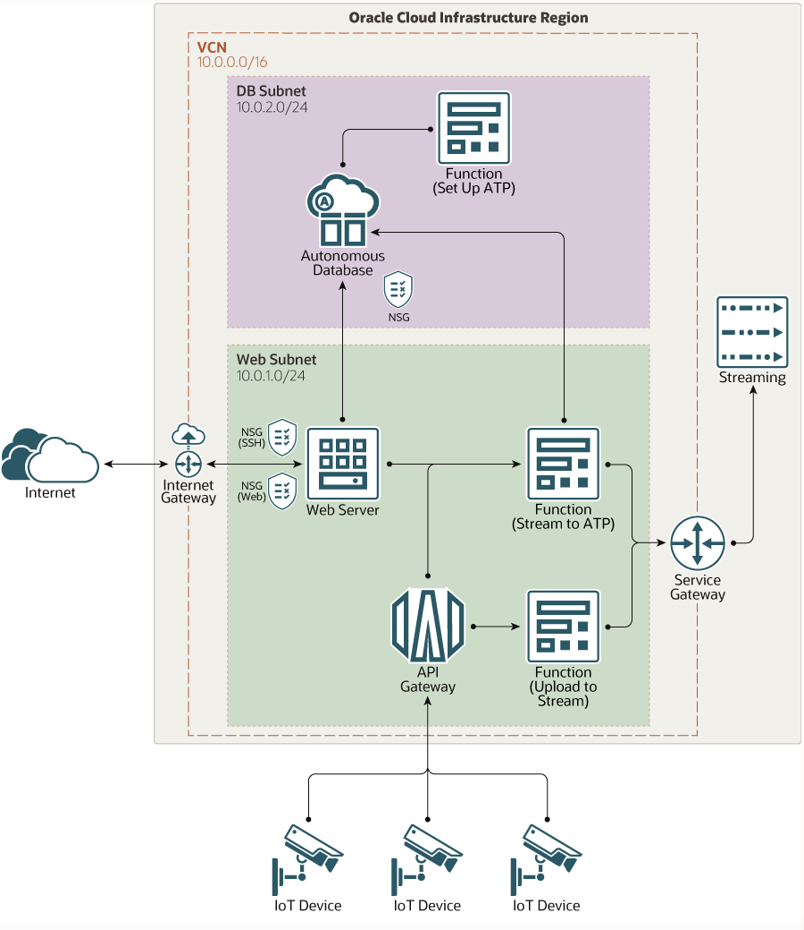
Ingestión de datos IoT usando funciones serverless
Arquitectura
Visión de Oracle
Arquitectura Serverless
Usa API Gateways y Functions para APIs
Ligero, escalable y cercano a tiempo real
Beneficios
Functions elimina el manejo de infraestructura y ofrece una solución autoescalable
API Gateway de alta disponibilidad y escalable
ADB reduce tareas operativas y administrativas
Casos de Uso
Tracking de inventario y activos en tiempo real
Manejo de flota
Telemedicina y dispositivos de salud
Ciudad inteligentes y trafico vehicular
Copyright © 2019, Oracle y/o sus filiales. Todos los derechos reservados.
Notes:
IoT (Internet of Things)-enabled workloads need to scale efficiently in real time. As you deploy more devices and sensors, the volume and variety of streamed data is bound to grow. Use serverless functions and an autonomous database in Oracle Cloud to automate and scale the processing of streamed IoT data.
In this architecture, data from IoT devices flows in through an API gateway to serverless functions, which use the Streaming service to upload the data to an autonomous database in Oracle Cloud. Users outside the cloud can access the data through a Flask-based web server running on an Oracle Cloud Infrastructure Compute instance.

Slide 25
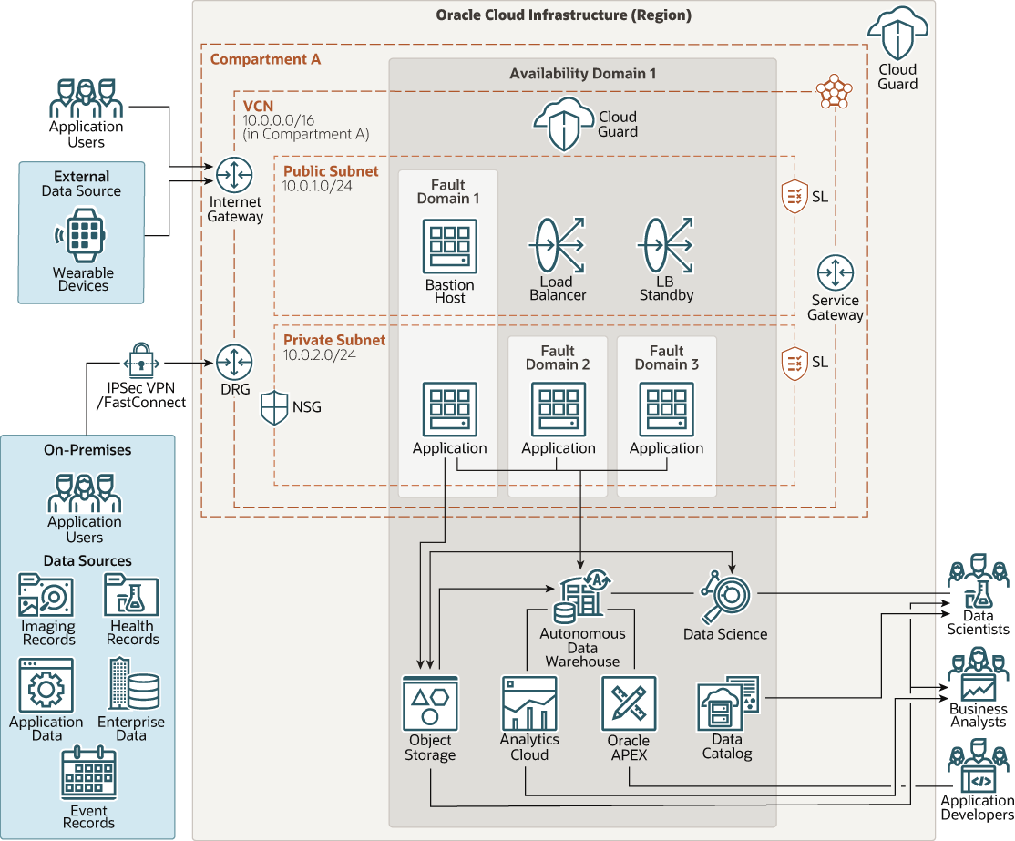
Data Science en salud
Arquitectura
Visión de Oracle
Arquitectura serverless completamente administrada
Bastion host, FastConnect (IPSec), Cloud Guard para Seguridad
Beneficios
Seguridad mejorada usando Cloud Guard, IPSec VPN, Bastion host
Arquitectura tolerante a fallos usando AD y FD
ADB reduce tareas operativas y administrativas
Aproximación Low Code mejora productividad y hace un diseño autogestionable
Casos de Uso
Predicción de enfermedades y diagnostico
Análisis de imagines medicas
Identificación de aplicación de drogas
Cuidado Personalizado
Copyright © 2019, Oracle y/o sus filiales. Todos los derechos reservados.
Notes:
Oracle Cloud Infrastructure Data Science (OCI) Data Science is a fully managed, serverless platform for data science teams to build, train, and manage machine learning models.
Data Science integrates with the rest of the OCI stack, including Oracle Functions, Data Flow, Autonomous Data Warehouse, and Object Storage. Oracle Accelerated Data Science (ADS) software developer kit (SDK) is a Python library that's included as part of the Data Science service, which has many functions and objects that automate or simplify the steps in the data science workflow, including connecting to data, exploring and visualizing data, training a model with AutoML, evaluating models, and explaining models. ADS also provides a simple interface to access the Data Science service model catalog and other OCI services, including Object Storage.
This flexible architecture supports multiple scenarios across integrated health networks based on Oracle Machine Learning service, combining Autonomous Data Warehouse and Data Science platforms.
In addition to Data Science and Autonomous Data Warehouse, this architecture also uses Data Catalog, Oracle APEX Application Development, and Oracle Analytics Cloud. It also uses OCI Compute instances to host applications that can dynamically stream wearable device data to either Autonomous Data Warehouse or Object Storage. This architecture serves multiple purposes, including storing important data in secure, reliable, and quick-retrieval storage, and building and deploying the applications and machine learning modules in short periods of time.

Slide 26
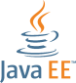




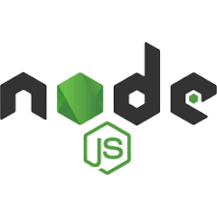







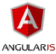







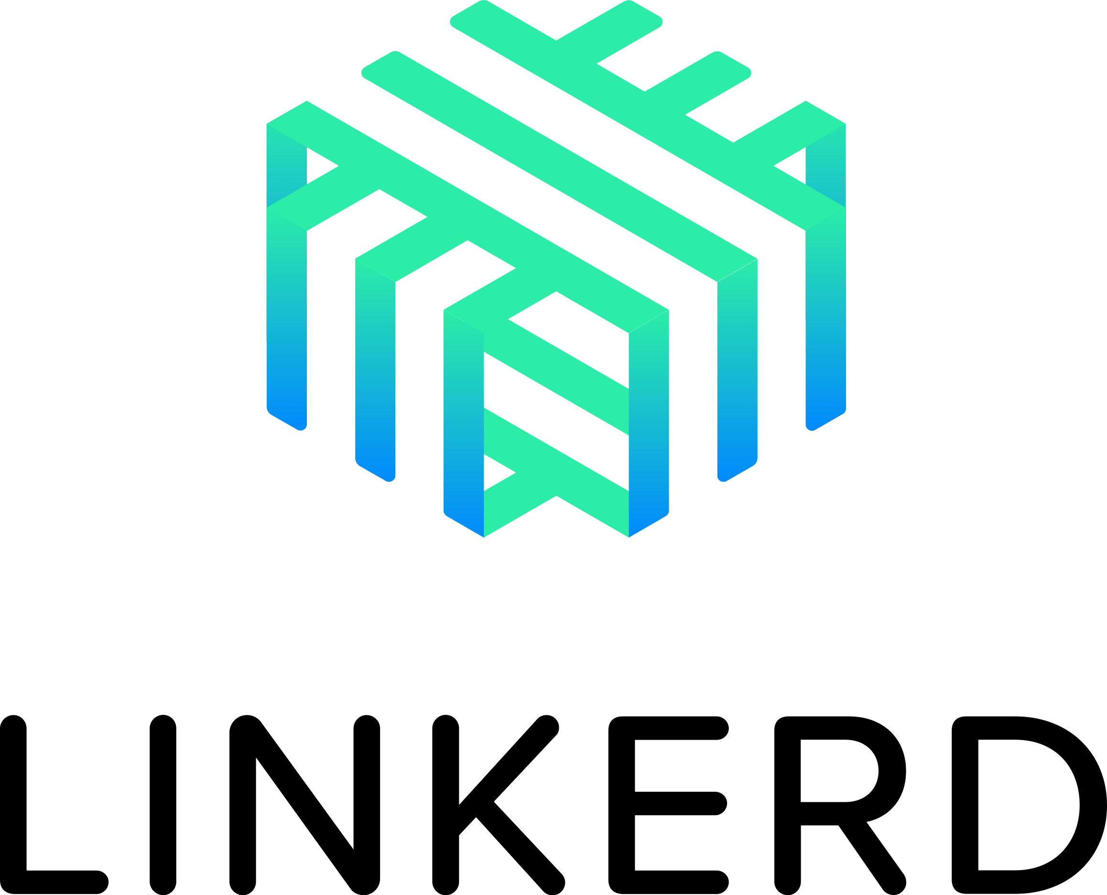





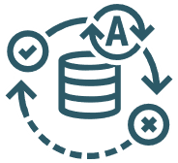


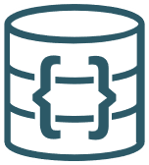









Application Development with Oracle Cloud
Developer
Tools & Ecosystem
Any Language, Any Framework
Low Code
API
AI/ML
Management and Security
Data Science
APEX
API Gateway &
Management
APM
Search
Digital Assistant
Blockchain
Cloud Shell
Container Native apps
Data Management
Monitoring
IAM
Functions
Events
Verrazzano
Service Connector Hub
Cloud Guard
Autonomous Database
MySQL
Data
Integration
NoSQL
Big Data
DevOps Service Visual Builder Studio
Containers Kubernetes
Container Registry
Streaming
Logging
Key Vault
Oracle Cloud Infrastructure
Compute
Storage
Networking
Load Balancer
Edge
Copyright © 2019, Oracle y/o sus filiales. Todos los derechos reservados.
Notes:
Oracle’s platform for developing apps for the cloud is open, modern and easy to use, and provides ML and data management capabilities. This slides shows what we offer to cloud app developers.
Oracle Cloud is open and offers choice, flexibility, portability, compatibility, and interoperability with other technologies, including open source and third-party components. Developers can build any kind of application on Oracle Cloud and can choose among:
Popular programming languages including Java, Node.js/JavaScript, Python, Ruby, Go, C#/.NET and more
Multiple databases for any data type, including Oracle Database, MySQL and NoSQL
Multiple operating systems, including Linux (Oracle, Ubuntu, CentOS, Debian, SUSE) and Windows Server
Infrastructure options, including containers, virtual machines, bare metal, Exadata and Cloud at Customer
Oracle Cloud enables developers to build modern applications using the latest technologies, architectures and development methodologies. For example, Oracle Cloud offers autonomous database technology, AI/ML, digital assistants, blockchain, Gen 2 cloud infrastructure, containers, Kubernetes, cloud native, serverless, DevOps tooling and more.
Oracle Cloud makes it fast and easy for developers to get started in minutes for what would otherwise take hours, days or weeks. Developers can build on top of rich platform functionality to avoid re-inventing the wheel. They can use familiar developer tools and frameworks to shorten the learning curve. They can let Oracle expertly manage the underlying services (Autonomous Database, managed Kubernetes, managed Terraform), so they can focus on building apps. Citizen developers can use low code platforms to quickly create applications without coding.
Oracle Cloud enables developers to build intelligent applications powered by machine learning and advanced analytics. For example, developers can use Digital Assistants which leverages conversational AI and natural language processing. Oracle Cloud also uses ML-driven analytics to automatically detect and predict systems management and security issues.

Slide 27


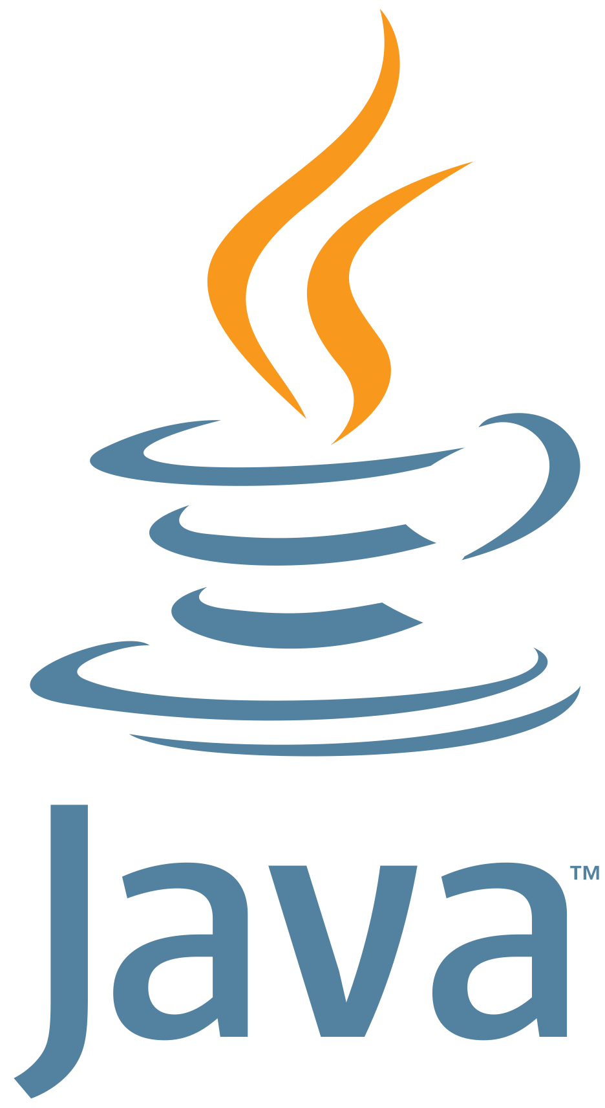
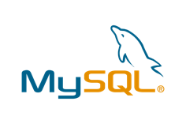

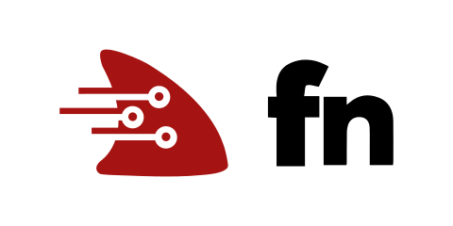
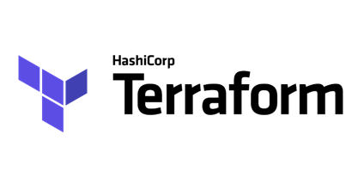
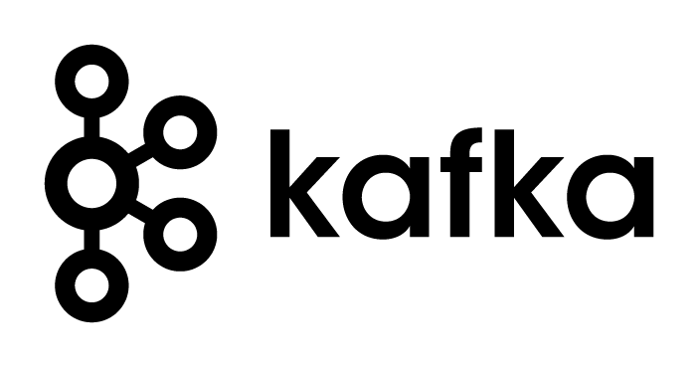



OCI promueve uso de estándares abiertos en su stack tecnológico
Tecnologia | Oracle Cloud
Lenguaje | Java
S.O | Autonomous Linux + OSMS
Contenedores | Docker/Kubernetes
Serverless | Fn-based Functions
Base de Datos | Oracle Database/MySQL
Proc. de Datos | Oracle Database/Spark
Automatización | Terraform
Eventos | CNCF Events
Streaming | Kafka-compatible
Gateway | API Gateway
APM | Monitors cloud and on-prem
Identity | SAML Federation, OAuth, OpenID
Multi-cloud | Azure Interconnect
Aplicaciones agiles y portables, evitar el “vendor lock-in”.
Usar su lenguaje y framework preferido.
Resource Manager: OCI Terraform-as-a-Service
Iniciativas de Código Abierto Soportadas
Copyright © 2019, Oracle y/o sus filiales. Todos los derechos reservados.
Notes:
ORACLE ESTA ABIERTO Y AOPYGANDO OPEN STANDARDS….Ver Blog.
Oracle embraces de-facto standards so customers have lower overhead and costs for technologies such as containers (Kubernetes), infrastructure as code (Terraform), serverless (CloudEvents, Functions), event streaming (Kafka), and APIs (OpenAPI). In addition, Oracle works with partners like Microsoft and VMware to enable simpler migration, lower risk, and fuller function cross-vendor applications.
You can run Oracle Database everywhere, but you can only run Aurora on AWS.

Slide 28
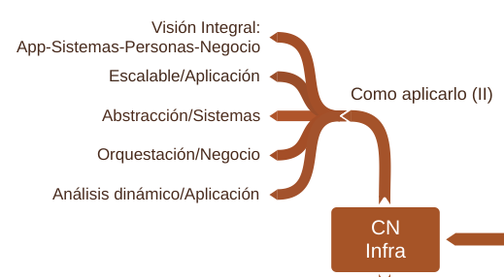
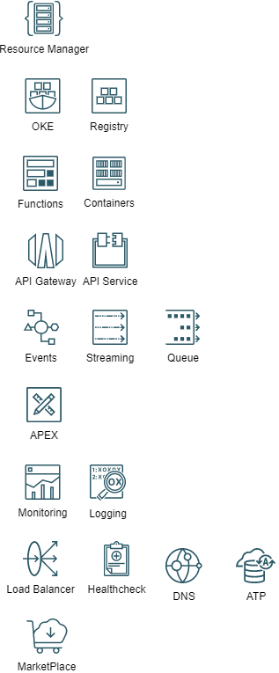
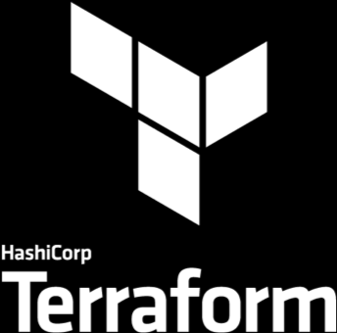


Administración e Infraestructura Cloud Nativa

Slide 29
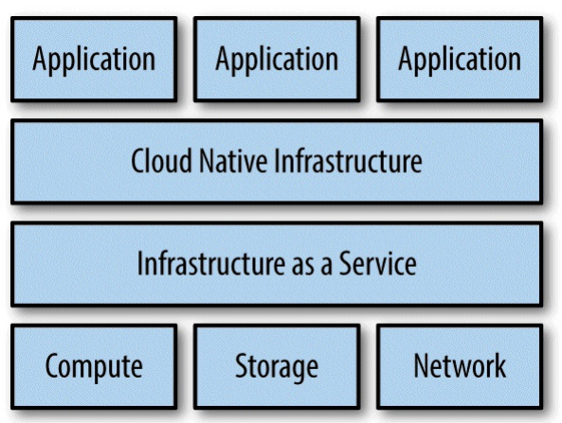
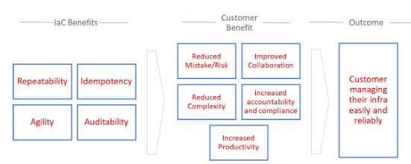

Despliegue: Resource Manager
 | Terraform
Visión Integral | Puede ser estricta
Escalable | Stack/Anidado
Abstracción | Compartment (Solo OCI) o Modular (TF)
Orquestación | Grafos Internos.
Análisis Dinámico | N/A
Patrón Reconciliación | Completo.

Slide 30
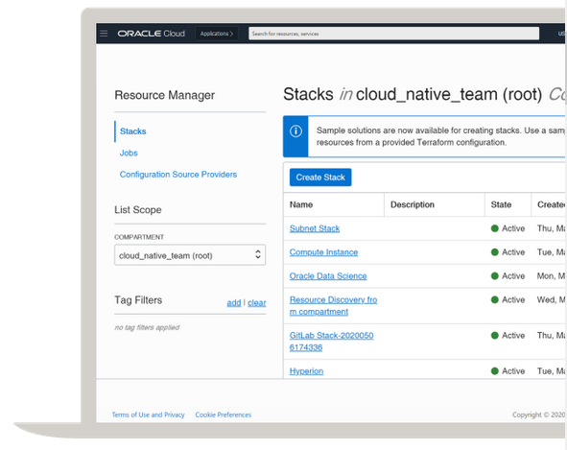
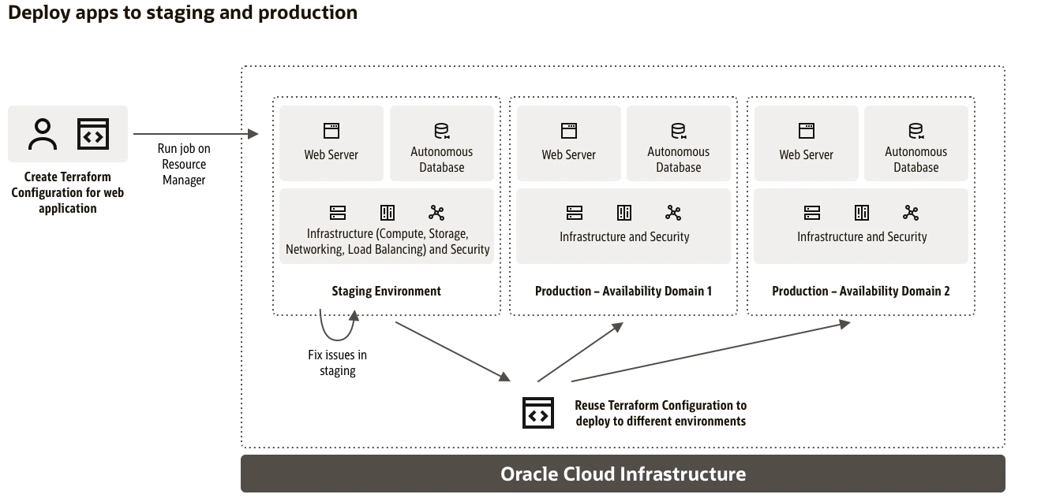
Resource Manager: Terraform
Resource Manager: Alta Integración con Terraform y como fuente GitHub, GitLab.
Promoción de entornos: Aislamiento

Slide 31
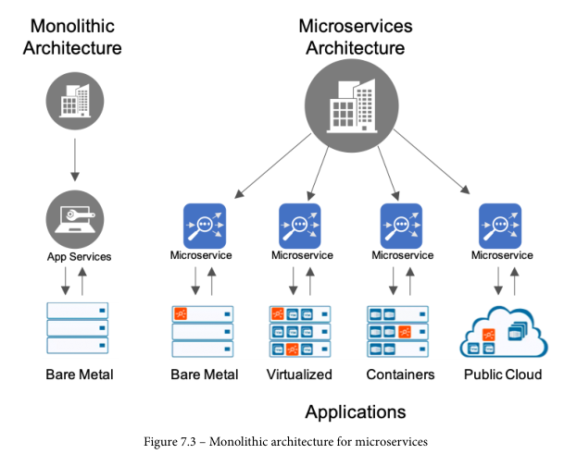
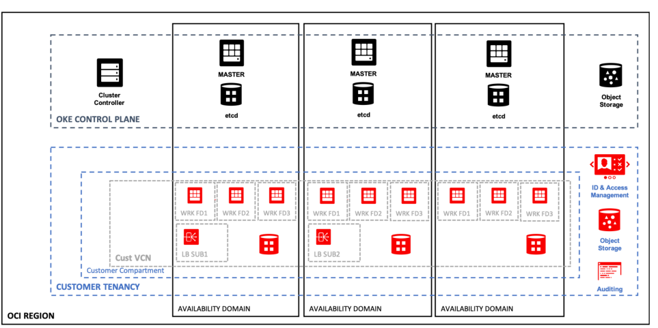
Despliegue y Ejecución: Kubernetes
 | Oracle Kubernetes Engine: Kubernetes
Visión Integral | Cluster/Clusters (Verazzano)
Escalable | Replicaset (Adecuado) /DaemonSet (1 Agente)
Abstracción | Deployment
Orquestación | Por Diseño
Análisis Dinámico | Servicio
Patrón Reconciliación | Completo
Integración y Opciones usando Recursos OCI: Computo, Load Balancers, Storage.

Slide 32
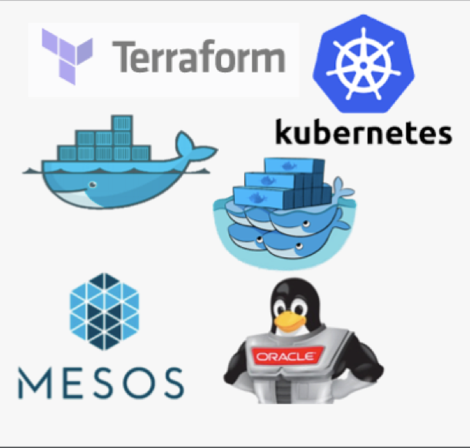
Maneras de Ejecutar Kubernetes en OCI
Oracle Cloud Infrastructure
Quickstart Experience (OSS Terraform Installer on GitHub)
Container Engine for Kubernetes (OKE)
Roll-Your-Own Container Management
Pre-Built Kubernetes Installer
Enterprise Class Managed Kubernetes Service
Copyright © 2019, Oracle y/o sus filiales. Todos los derechos reservados.
Notes:
Formal name: Oracle Cloud Infrastructure Container Engine for Kubernetes
Enables developers to get started and deploy containers quickly, DevOps teams with Kubernetes management, visibility and control.
Combines production grade container orchestration of open Kubernetes, with control, security and high predictable performance of Oracle’s next generation OCI cloud infrastructure

Slide 33

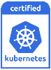
Container Engine for Kubernetes - OKE y Registry
Cloud Native
Standard Docker y Kubernetes
Integración con Registry, Red y Storage
Integración con Desarrollo
Streamlined workflow
Full REST API
Add-ons de Cluster preconstruidos
Estándares Abiertos – Kubernetes sin modificar.
Enfoque Empresarial
Operadores Simples para Clúster
Rendimiento para Full BM y HA IaaS (GPU, ARM)
Clústeres Autónomos (Zero Downtime para Updates)
Oracle Managed
Customer Managed
OCI Registry
OCI Container Engine for Kubernetes
Customer’s OCI Account/Tenancy
Gratis
Gratis
Paga solo los recursos usados para ejecutarlos (VM’s, BS, FSS, LB, OS-OCIR etc.)
Cluster Management
VM based Clusters and Nodes
In-flight and at rest data encryption
HA - 3 Masters/etcd across 3 ADs
Bare Metal Clusters and Nodes
Container Engine Dashboard
Oracle Cloud Infrastructure
Costos
Sin costo para el Control Plane (50 cores, 750GB RAM), Trafico entre AD, Zonas de Seguridad y Cloud Guard.
Copyright © 2019, Oracle y/o sus filiales. Todos los derechos reservados.

Slide 34
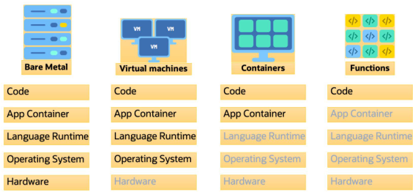
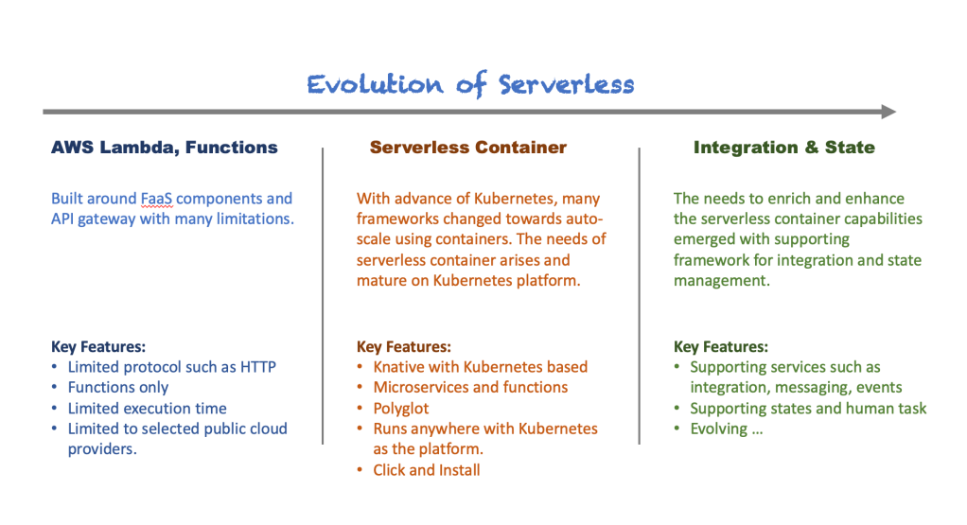
Despliegue y Ejecucion: Serverless
 | Function Fn: Serverless
Visión Integral | Dentro de su App.
Escalable | Nativo
Abstracción | 2 niveles: App y Function
Orquestación | Externa.
Descubrimiento Dinámico | N/A
Patrón Reconciliación | N/A

Slide 35
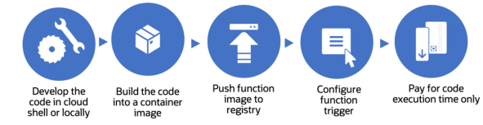
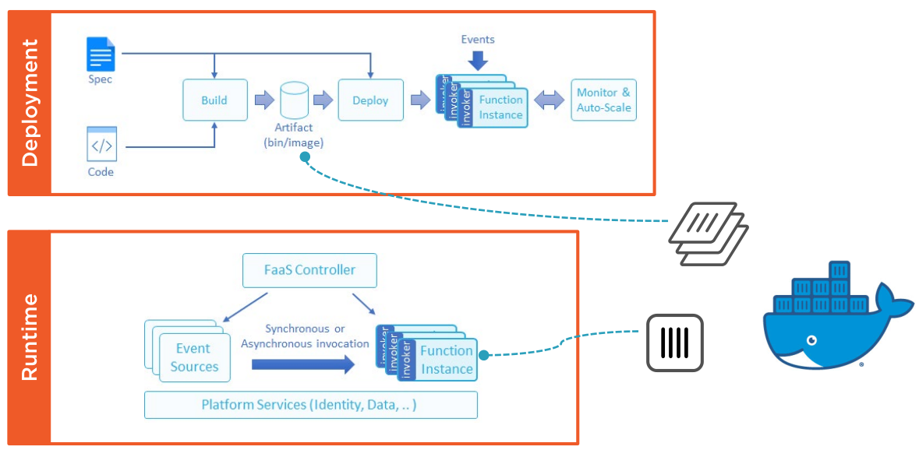
Construcción Local y ambientes separados
Tomado de https://app.pluralsight.com/library/courses/serverless-programming-fn-project, y https://braindose.blog/2020/08/13/differences-between-function-serverless-knative/

Slide 36
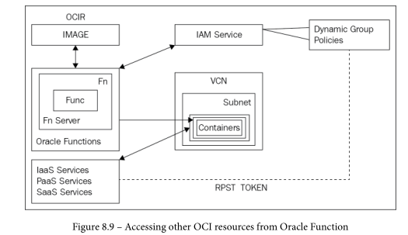
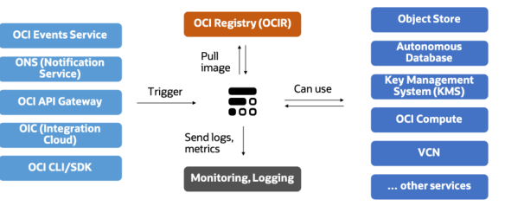


Arquitectura y Ejecucion

Slide 37


API Management: API Gateway y Apiary
Ejemplos de Uso:
Mock Service
Llamada un HTTP/Passtrough
Llamada a servicio OCI: LB, OKE, Function, etc.
Características:
Autenticación / Autorización
CORS
Rate Limit (Throtling)
Validacion Header/Request
Transformacion
….
API Gateway:
API gateway within a cloud environment
API gateway in a cloud to on-premises model
API gateway in a hybrid model
API gateway in a private cloud model

Slide 38

Demo Time
Requerimientos:
Docker: WSL2, Docker Desktop
OCI CLI: WSL2
Accounts-OCI: francisco.m.moreno
Accounts-Docker Hub: fmorenod
GitHub: fmorenod81
Configuración OCI CLI:
OCI CLI: Profile
Docker Login: OCIR – Auth Token
Configuración OCI Web:
Repository
Functions
API Gateway

Slide 39

Pasos locales
Verificar ambiente
Paso 1: Hello World
Crear HelloWorld
Desplegarlo localmente
Invocarlo
Paso 2: Event-Count
Copiar Codigo event-count
Desplegarlo localmente
Invocarlo

Slide 40
Pasos remotos
Paso 3:
Crear repositorio
Crear contexto
Configurar contexto
Subir repositorio
Verificar Políticas Seguridad
Invocar remotamente
Configurar API Gateway
Configurar DNS

Slide 41

Q&A
EPAM ANYWHERE
Para más información contacta: svitlana_martyniuk@epam.com
Lead Talent Acquisition Consultant @ EPAM Anywhere
https://epa.ms/anywhere-webinar

